Slide 1

CARC103 – Computer Architecture
Kent Institute Australia Pty. Ltd.
ABN 49 003 577 302 CRICOS Code: 00161E RTO Code: 90458 TEQSA Provider Number: PRV12051

Slide 2

Chapter 3 Part 1
Boolean Algebra and Digital Logic

Slide 3
Objectives
Understand the relationship between Boolean logic and digital computer circuits.
Learn how to design simple logic circuits.
Understand how digital circuits work together to form complex computer systems.

Slide 4
Logic Gates
We have looked at Boolean functions in abstract terms.
In this section, we see that Boolean functions are implemented in digital computer circuits called gates.
Logic gates perform basic logical functions and are the fundamental building blocks of digital integrated circuits.
A gate is an electronic device that produces a result based on two or more input values. Most logic gates take an input of two binary values, and output a single value of a 1 or 0.
In reality, gates consist of one to six transistors, but digital designers think of them as a single unit.
Integrated circuits contain collections of gates suited to a particular purpose.

Slide 5
Logic Gates
There are seven different types of logic gates, which are outlined below:
AND - True if A and B are both True
OR - True if either A or B are True
NOT - Inverts value: True if input is False; False if input is True
XOR - True if either A or B are True, but False if both are True or False
NAND - AND followed by NOT: False only if A and B are both True
NOR - OR followed by NOT: True only if A and B are both False
XNOR - XOR followed by NOT: True if A and B are both True or both False

Slide 6
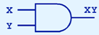
Logic Gates – AND Gate
Symbol | Formula | Truth Table | Boolean Expression
 | F(X, Y) = X.Y
X | Y | XY
0 | 0 | 0
0 | 1 | 0
1 | 0 | 0
1 | 1 | 1
Boolean Algebra Rules | Clarification
X . X = X | 0.0 = 0 / 1.1 = 1
X . X’ = 0 | 0.1 = 0 / 1.0 = 0
X . 0 = 0 | 1.0 = 0 / 0.0 = 0
X . 1 = X | 1.1 = 1 / 0.1 = 0

Slide 7
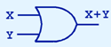
Logic Gates – OR Gate
Symbol | Formula | Truth Table | Boolean Expression
 | F(X, Y) = X+Y
X | Y | X+Y
0 | 0 | 0
0 | 1 | 1
1 | 0 | 1
1 | 1 | 1
Boolean Algebra Rules | Clarification
X + X = X | 0 + 0 = 0 / 1 + 1 = 1
X + X’ = 1 | 0 + 1 = 1 / 1 + 0 = 1
X + 0 = X | 0 + 0 = 0 / 1 + 0 = 1
X + 1 = 1 | 0 + 1 = 1 / 1 + 1 = 1

Slide 8
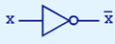
Logic Gates – NOT Gate
Symbol | Formula | Truth Table
 | F(X) = X’
X | X’
0 | 1
1 | 0

Slide 9
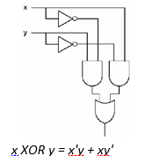
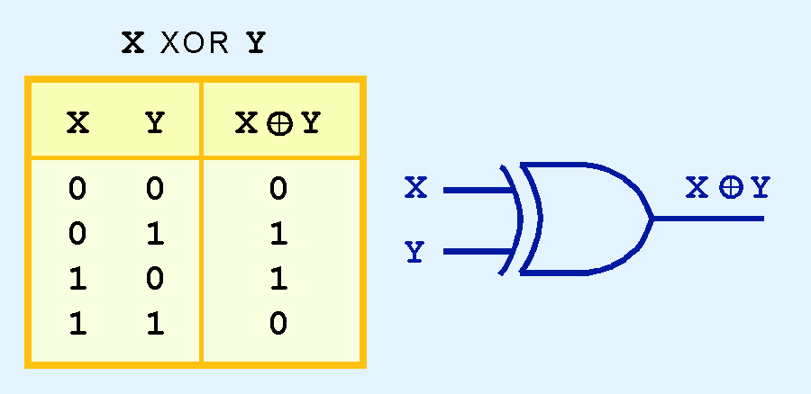
Logic Gates - Exclusive OR (XOR) Gate
Another very useful gate is the exclusive OR (XOR) gate.
The output of the XOR operation is true only when the values of the inputs differ.
Note the special symbol ⊕ for the XOR operation.

Slide 10
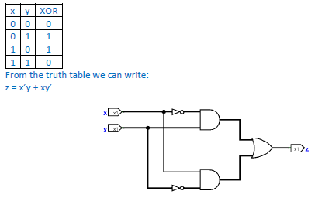
Q- Construct a circuit for XOR operation without using an XOR gate

Slide 11
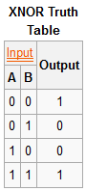
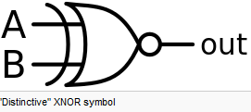
Logic Gates - Exclusive NOR (XNOR) Gate
Another very useful gate is the exclusive NOR (XNOR) gate.
The XNOR gate is a digital logic gate whose function is the inverse of the exclusive OR (XOR) gate.
Note the special symbol  for the XNOR operation.

Slide 12
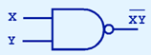
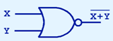
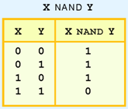
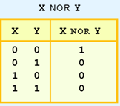
Logic Gates – NAND and NOR Gates
NAND Gate | NOR Gate
NAND and NOR are two very important gates. Their symbols and truth tables are shown at the right.

Slide 13
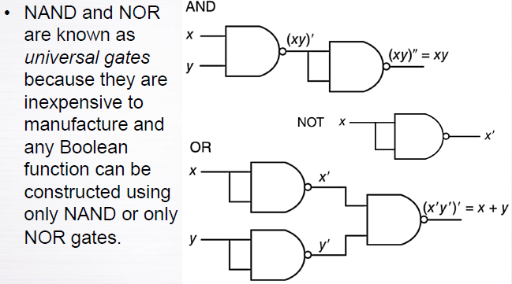
Logic Gates – NAND and NOR Gates

Slide 14
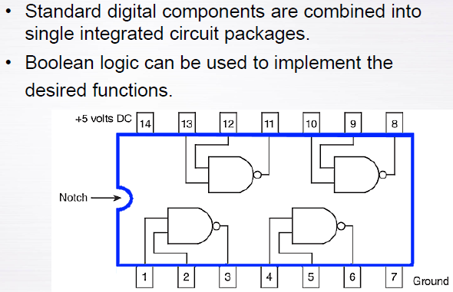
Digital Components

Slide 15
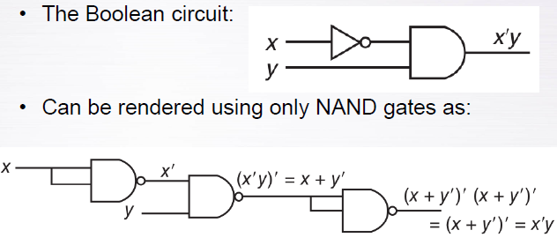
Digital Components

Slide 16
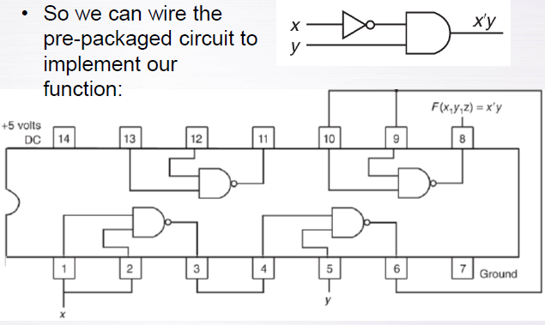
Digital Components

Slide 17
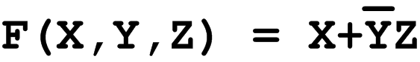
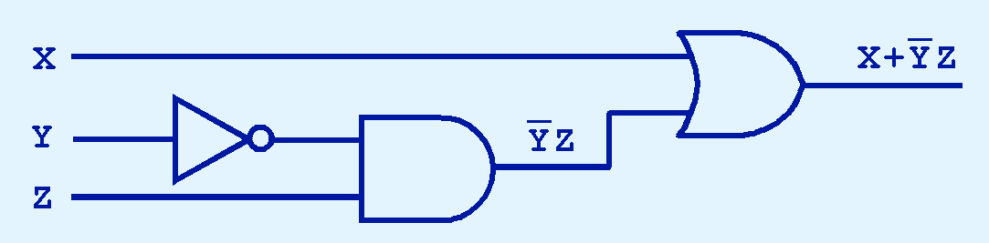
Logic Gates
The main thing to remember is that combinations of gates implement Boolean functions.
The circuit below implements the Boolean function:
X | Y | Z | Y’ | Y’Z | X + Y’Z
0 | 0 | 0 | 1 | 0 | 0
0 | 0 | 1 | 1 | 1 | 1
0 | 1 | 0 | 0 | 0 | 0
0 | 1 | 1 | 0 | 0 | 0
1 | 0 | 0 | 1 | 0 | 1
1 | 0 | 1 | 1 | 1 | 1
1 | 1 | 0 | 0 | 0 | 1
1 | 1 | 1 | 0 | 0 | 1
We simplify our Boolean expressions so that we can create simpler circuits.

Slide 18
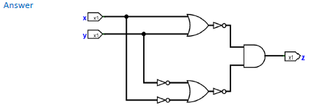
Q- Draw a combinational circuit that implements the following Boolean function. Do not attempt to simplify the function. z = (x + y)’ (x' + y')'

Slide 19
Boolean Algebra
Boolean algebra is a mathematical system for the manipulation of variables that can have one of two values.
In formal logic, these values are “true” and “false.”
In digital systems, these values are “on” and “off,” 1 and 0, or “high” and “low.”
Boolean expressions are created by performing operations on Boolean variables.
Common Boolean operators include AND, OR, and NOT.

Slide 20
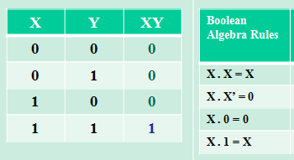
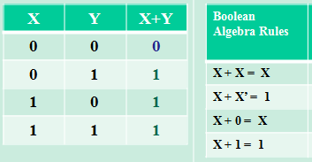
Boolean Algebra - AND and OR Boolean Operator
A Boolean operator can be completely described using a truth table.
The truth table for the Boolean operators AND and OR are shown at the right.
The AND operator is also known as a Boolean product. The OR operator is the Boolean sum.
AND | OR

Slide 21
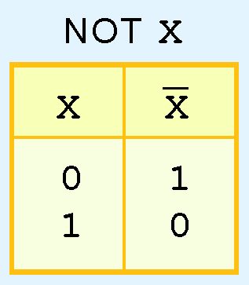
Boolean Algebra – NOT Boolean Operator
The truth table for the Boolean NOT operator is shown at the right.
The NOT operation is most often designated by an overbar. It is sometimes indicated by a prime mark ( ‘ ) or an “elbow” (¬).

Slide 22
Boolean Algebra
A Boolean function has:
At least one Boolean variable,
At least one Boolean operator, and
At least one input from the set {0,1}.
It produces an output that is also a member of the set {0,1}.
Now you know why the binary numbering system is so handy in digital systems.

Slide 23
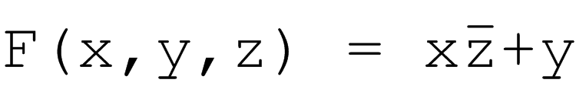
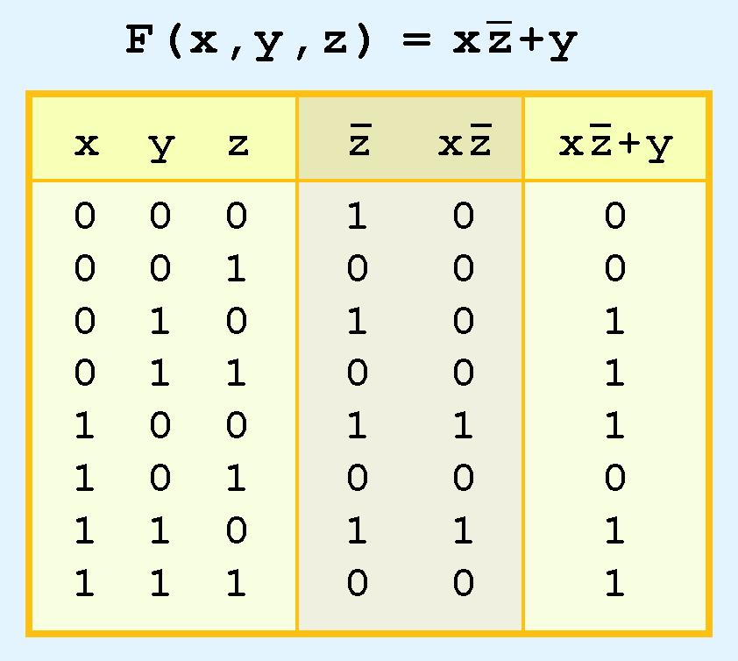
Boolean Algebra
To make evaluation of the Boolean function easier, the truth table contains extra (shaded) columns to hold evaluations of subparts of the function.
As with common arithmetic, Boolean operations have rules of precedence.
The NOT operator has highest priority, followed by AND and then OR.
This is how we chose the (shaded) function subparts in our table.

Slide 24
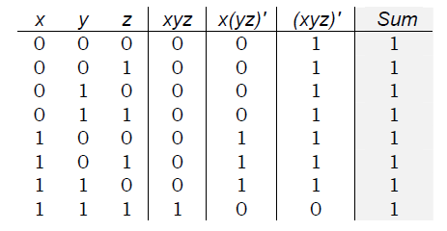
Boolean Algebra
Example (1): Construct a truth table for the following:
Sum(x, y, z) = xyz + x(yz)' + (xyz)'

Slide 25
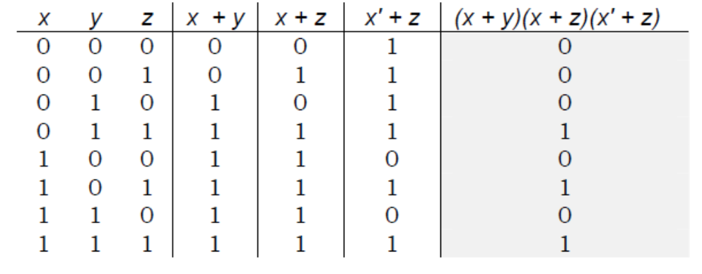
Boolean Algebra
Q1:
Answer:
Construct a truth table for the following:
(x + y)(x + z)(x' + z)

Slide 26
Boolean Algebra
Digital computers contain circuits that implement Boolean functions.
The simpler that we can make a Boolean function, the smaller the circuit that will result.
Simpler circuits are cheaper to build, consume less power, and run faster than complex circuits.
With this in mind, we always want to reduce our Boolean functions to their simplest form.
There are a number of Boolean identities that help us to do this.

Slide 27
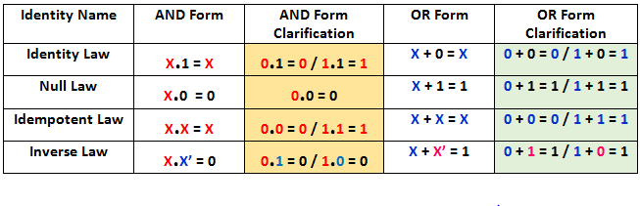
Boolean Algebra - First Group of Boolean
Most Boolean identities have an AND (product) form as well as an OR (sum) form. We give our identities using both forms.
Our first group of Boolean is rather intuitive:

Slide 28
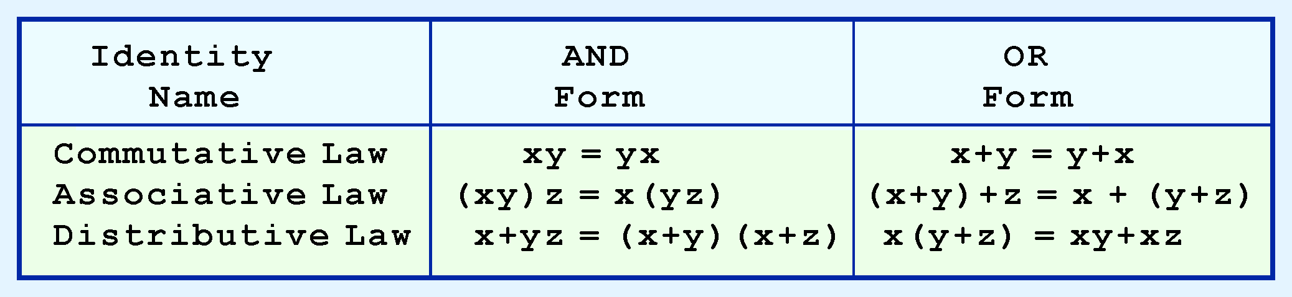
Boolean Algebra – Second Group of Boolean
Our second group of Boolean identities should be familiar to you from your study of algebra:
Prove that X + YZ = (X + Y)(X + Z)
= X + YZ = X.1 + YZ [Since, X.1 = X] = X(1 + Y) + YZ [Since, Y+1 = 1] = X.1 + XY + YZ = X.(1 + Z) + XY + YZ
= XX + XZ + XY + YZ [Since, X.X = X.1 = X] = X (X + Z) + Y (X+Z) X+YZ = (X+Y)(X+Z)

Slide 29
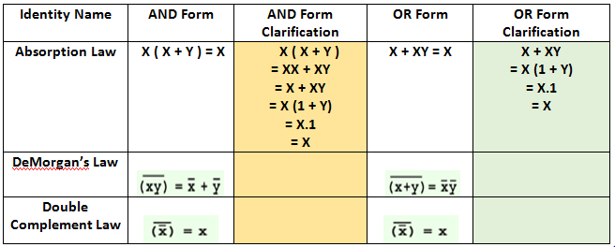
Boolean Algebra – Third Group of Boolean
Our third and last group of Boolean identities are perhaps the most useful.
If you have studied set theory or formal logic, these laws are also familiar to you.

Slide 30
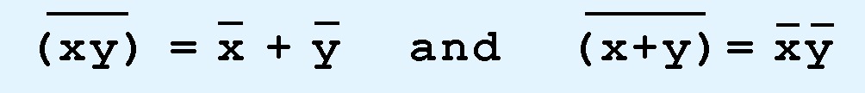
Boolean Algebra - DeMorgan’s law
Sometimes it is more economical to build a circuit using the complement of a function (and complementing its result) than it is to implement the function directly.
DeMorgan’s law provides an easy way of finding the complement of a Boolean function.
Recall DeMorgan’s law states:

Slide 31
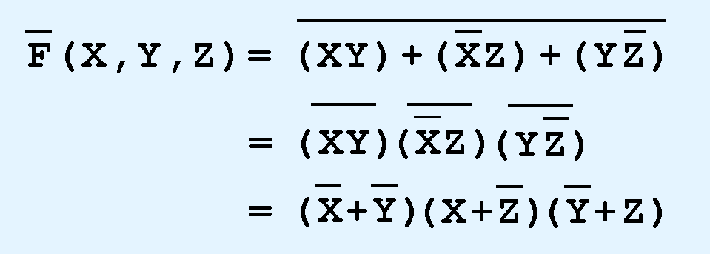
Boolean Algebra - DeMorgan’s law
DeMorgan’s law can be extended to any number of variables.
Replace each variable by its complement, and
Change all ANDs to ORs and all ORs to ANDs.
Thus, we find the complement of:
is:

Slide 32
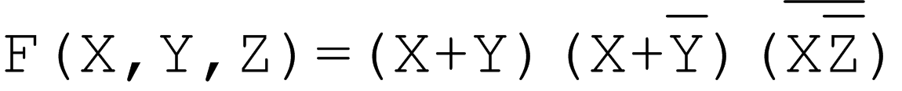
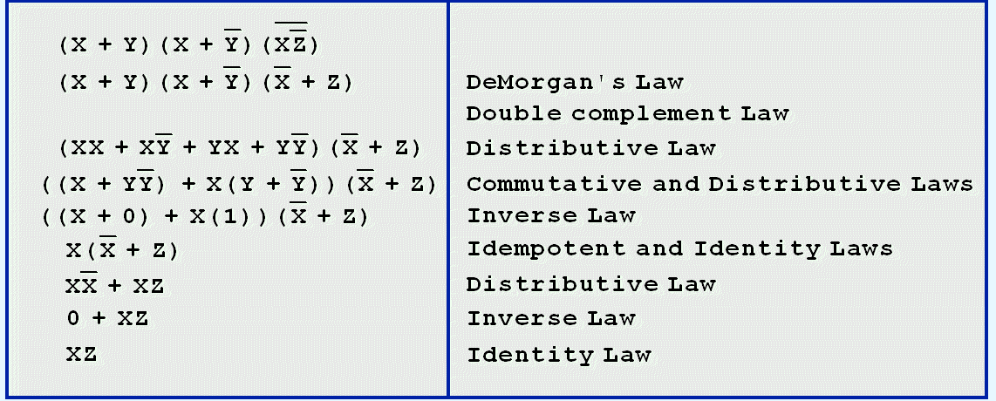
Boolean Algebra
We can use Boolean identities to simplify:
as follows:

Slide 33
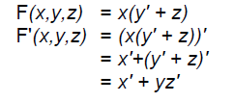
Boolean Algebra - DeMorgan’s law
Example(2): Using DeMorgan's Law, write an expression for the complement of F if
F(x,y,z) = x(y' + z).

Slide 34
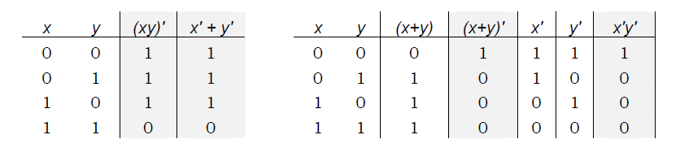
Boolean Algebra - DeMorgan’s law
Example(3): Using a truth table prove DeMorgan's Laws are valid in the following two truth tables.

Slide 35
Boolean Algebra - Examples
F1 = (A + B) (A + C)
= AA + AC + AB + BC
= A + AC + AB + BC
= A (1 + C) + AB + BC
= A + AB + BC
= A (1 + B) + BC
= A + BC

Slide 36
Boolean Algebra - Examples
F2 = BBC + BC’C’ + A’BC + A’BC’
= BBC + BC’C’ + A’B (C + C’)
= BBC + BC’C’ + A’B.1
= BBC + BC’C’ + A’B
= BC + BC’ + A’B
= B (C + C’) + A’B
= B.1 + A’B
= B (1 + A’)
= B
Another Solution
F2 = BBC + BC’C’ + A’BC + A’BC’
= BC +BC’ +A’BC + A’BC’
= BC (1+A’) +BC’(A’+1)
= BC +BC’
= B (C+C’)
= B

Slide 37
Boolean Algebra
Example(4): Using the basic identities of Boolean algebra, show that:
x(x' +y) = xy
x(x' +y) = xx’ + xy
= 0 + xy
= xy

Slide 38
Boolean Algebra
Example(5): Simplify the following functional expressions using Boolean algebra and its identities. List the identity used at each step.
xy + xy'
xy + xy‘ = x (y + y’) Distributive
= x (1) Inverse
= x Identity

Slide 39
Boolean Algebra
Example(6): Simplify the following functional expressions using Boolean algebra and its identities. List the identity used at each step.
wx + w(xy + yz')
wx + w(xy + yz') = wx + wxy + wyz’ Distributive
= wx (1 + y) + wyz’ Distributive
= wx (1) + wyz’ Null
= wx + wyz’ Identity

Slide 40
Boolean Algebra
Example(7): Use any method to prove the following either True for False.
yz + xyz' + x' y' z = xy + x' z
yz + xyz' + x' y' z = (x + x’) yz + xyz’ + x’y’z
= xyz + x’yz + xyz’ + x’y’z
= (xyz + xyz’) + (x’yz + x’y’z)
= xy (z + z’) + x’z (y + y’)
= xy + x’z

Slide 41

Boolean Algebra
Q2: Using the basic identities of Boolean algebra, show that:
xy + x'z + yz = xy + x' z

Slide 42
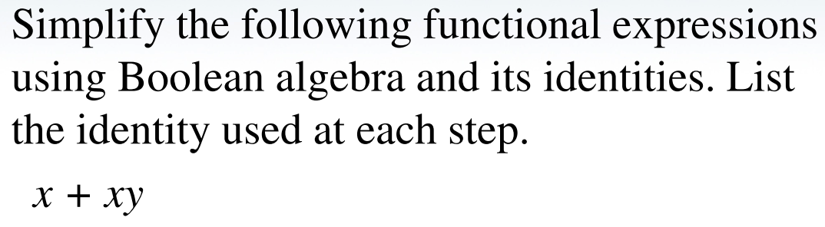
Boolean Algebra
Q3:

Slide 43
Boolean Algebra
Q4:
Simplify the following functional expressions using Boolean algebra and its identities. List the identity used at each step.
(xy‘ + x‘z)(wx‘ + yz‘)

Slide 44
Boolean Algebra
Q5:
Using The basic identities of Boolean algebra, show that:
xz = (x + y)(x + y’)(x’ + z)

Slide 45
Boolean Algebra
Q6:
Simplify the following functional expressions using Boolean algebra and its identities. List the identity used at each step.
a) x'yz + x'yz' + xyz + xyz'
b) w'x'y'z' + w'xy'z' + xx'y'z'

Slide 46
Boolean Algebra
Q7:
Simplify the following functional expressions using Boolean algebra and its identities. List the identity used at each step.
(ab + c + df)ef

Slide 47
Boolean Algebra
Through our exercises in simplifying Boolean expressions, we see that there are numerous ways of stating the same Boolean expression.
These “synonymous” forms are logically equivalent.
Logically equivalent expressions have identical truth tables.
In order to eliminate as much confusion as possible, designers express Boolean functions in standardized or canonical form.

Slide 48
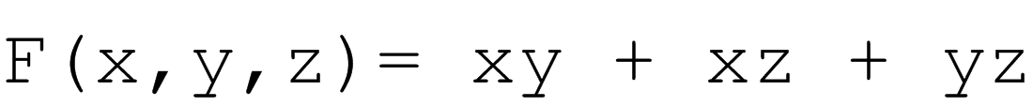
Boolean Algebra
There are two canonical forms for Boolean expressions: sum-of-products and product-of-sums.
Recall the Boolean product is the AND operation and the Boolean sum is the OR operation.
In the sum-of-products form, ANDed variables are ORed together.
For example:
In the product-of-sums form, ORed variables are ANDed together:
For example:

Slide 49
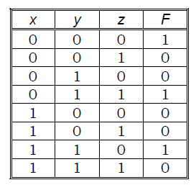
Boolean Algebra - Sum-of-Products Form
Q9: The truth table for a Boolean expression is shown below. Write the Boolean expression in sum-of-products form.

Slide 50
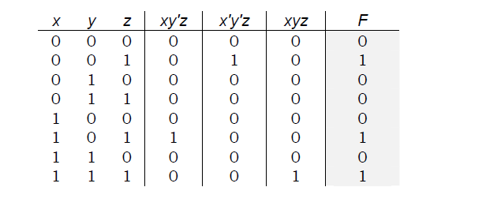
Combinational Circuits
Example(9): Given the function: F(x,y,z)= xy'z + x'y'z + xyz
a. List the truth table for F.

Slide 51
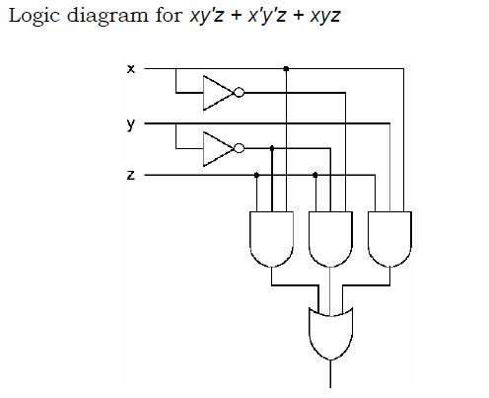
Combinational Circuits/ Example- Cont..
Example(9) Cont....
b. Draw the logic diagram using the original Boolean expression
Notes:
Draw the logic diagram using the original Boolean expression xy’z + x’y’z + xyz = Y

Slide 52
Combinational Circuits
Example(9) Cont....
c. Simplify the expression using Boolean algebra and identities.
F(x,y,z)= xy'z + x'y'z + xyz Apply identity: A = A + A (xy'z) + x'y'z + xyz (xy'z + xy'z) + x'y'z + xyz Reorder and factor: xy'z + x'y'z + xy'z + xyz (xy'z + x'y'z) + (xy'z + xyz) y'z(x + x') + xz(y' + y) Apply identity: A + A' = 1 y'z(1) + xz(1) y'z + xz

Slide 53
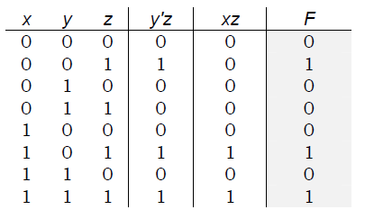
Combinational Circuits
Example(9) Cont....
d. List the truth table for your answer in Part c.

Slide 54
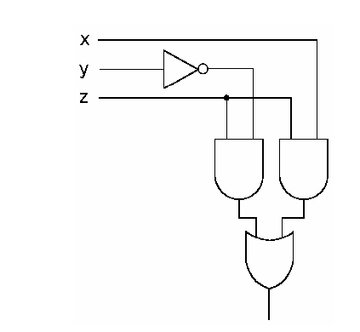
Combinational Circuits
Example(9) Cont....
e. Draw the logic diagram for the simplified expression in Part c.

Slide 55
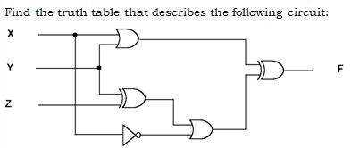
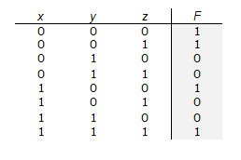
Combinational Circuits
Example 10:
Answer:
X | Y | Z | F1=X+Y | F2=Y XOR Z | X’ | F3=X’+F2 | F=F1 XOR F3
0 | 0 | 0 | 0 | 0 | 1 | 1 | 1
0 | 0 | 1 | 0 | 1 | 1 | 1 | 1
0 | 1 | 0 | 1 | 1 | 1 | 1 | 0
0 | 1 | 1 | 1 | 0 | 1 | 1 | 0
1 | 0 | 0 | 1 | 0 | 0 | 0 | 1
1 | 0 | 1 | 1 | 1 | 0 | 1 | 0
1 | 1 | 0 | 1 | 1 | 0 | 1 | 0
1 | 1 | 1 | 1 | 0 | 0 | 0 | 1

Slide 56
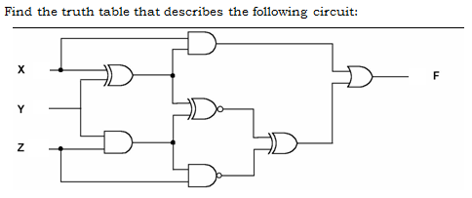
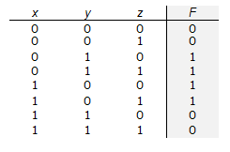
Combinational Circuits
Q11:
Answer
X | Y | Z | F1=X XOR Y | F2=Y.Z | F3=X.F1 | F4=F1 XNOR F2 | F5=F2 NAND Z | F6=F4 XOR F5 | F=F3 + F6
0 | 0 | 0 | 0 | 0 | 0 | 1 | 1 | 0 | 0
0 | 0 | 1 | 0 | 0 | 0 | 1 | 1 | 0 | 0
0 | 1 | 0 | 1 | 0 | 0 | 0 | 1 | 1 | 1
0 | 1 | 1 | 1 | 1 | 0 | 1 | 0 | 1 | 1
1 | 0 | 0 | 1 | 0 | 1 | 0 | 1 | 1 | 1
1 | 0 | 1 | 1 | 0 | 1 | 0 | 1 | 1 | 1
1 | 1 | 0 | 0 | 0 | 0 | 1 | 1 | 0 | 0
1 | 1 | 1 | 0 | 1 | 0 | 0 | 0 | 0 | 0

Slide 57
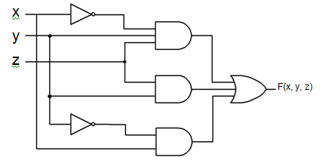
Combinational Circuits
Q12:
Answer
Draw the combinational circuit that directly implements the following Boolean expression:
F(x,y,z) = x'yz + yz + xy'

Slide 58
Boolean Algebra - Sum-of-Products Form
Q10:
Draw the truth table and rewrite the expression below as the complement sum of two products:
xz’ + y’z + x’y

Slide 59

kent.edu.au Kent Institute Australia Pty. Ltd. ABN 49 003 577 302 ● CRICOS Code: 00161E ● RTO Code: 90458 ● TEQSA Provider Number: PRV12051

